Slide 1

The Role of Technology in the Secondary Education Sector of Southern Cameroon.
Research Project Presented by:
Edugu Julius Edugu
Business School, Atlantis University
MBA 701: Business Capstone
Prof. Jorge Betancourt

Slide 2




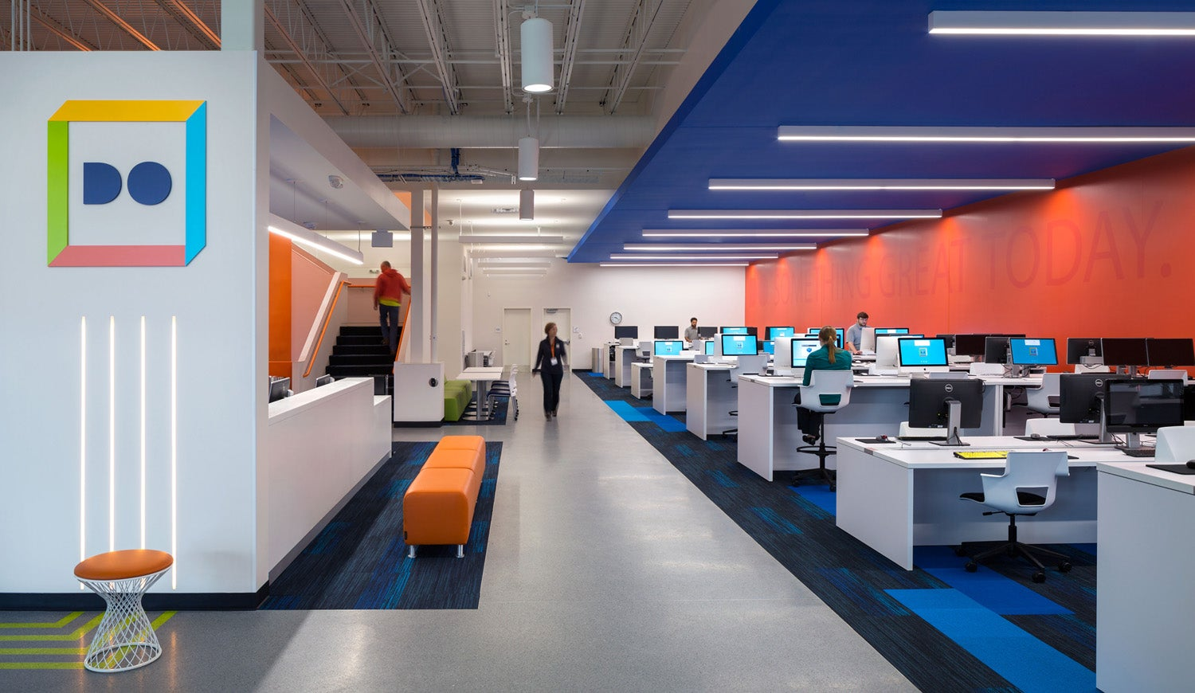
Introduction Education is one of the main factors that allow people to grow and develop as individuals. Technology has become one of those tools that individuals use to enhance learning. Technology has two major roles on education. That is, the removal of physical barriers to learning and the transition of focus from the retention of knowledge to its utilization. The role of technology in education varies from country to country depending on the tools used and how it is been implemented.

Slide 3
Objectives and Motivations
Objectives
The main objective of this project is to analyze the role technology of technology in the education sector of different countries and at the end make some recommendations on how technology could be used in Southern Cameroon to produce more effective results.
Also, I will examine the different role technology is playing in various continents.
Motivations
I am motivated by the role technology played in the education sector of the world during the outbreak of COVID-19 pandemic.
Another motivation is the way technology is helping students to develop real world skills like problem solving, communication, teamwork, and leadership.

Slide 4

1. Removal of physical barriers to learning
2. Promotes effective educational system with various technology tools
3. Helps students learn much and better with 24/7 availability and accessibility of resources
4. Improvise better communication and collaboration
5. Improve teachers’ proficiency and productivity
6. Better understanding through video graphics
7. Learning at own pace
8. Efficient problem-solving stuff
9. Improvement of learning skills with tutorials, blogs, and websites
10. Save time and money
Roles of Technology in
Education

Slide 5
Comparing the role of technology in different countries
 | USA | Kenya | Japan | Cameroon
Removal of physical barrier | √ | √ | √ | √
Promotes effective educational system | √ | √ | √ | ×
Technology helps students learn much and better | √ | √ | √ | √
Improve teachers’ productivity and efficiency | √ | √ | √ | √
Improve better communication and collaboration | √ | × | √ | ×
Better understanding through video graphics | √ | × | √ | ×
Learning at own pace | √ | √ | √ | √

Slide 6

Google classroom
Google Docs
Flipgrid
YouTube
Zoom
Kahoot
Quizlet
Canva
TED-Ed
Seesaw
Nearpod
Edtech Tools
Edtech tools | Japan | Kenya | USA | Cameroon
Google Classroom | √ | √ | √ | √
Zoom | √ | X | √ | X
Flipgrid | √ | X | √ | X
Google Doc | √ | X | √ | X
Nearpod | X | √ | √ | X
Canva | √ | X | √ | X
TED-Ed | √ | √ | √ | √
Kahoot | √ | X | √ | X

Slide 7
Analyzing the Role of Technology in Different countries. Case study: United States
To improve better communication and collaboration
This was achieved using tools like zoom and Google Doc
Students following tan expedition of a group of scientists by
Reading the scientists blog posting and viewing photos
Send emails and organize video conferencing for more clarity
Students share their opinions with others via google classrom

Slide 8
Case study: Kenya
To promote effective educational system and helps students learn better
Using Nearpod and electronic blackboard.
Students use Nearpod to communicate with peers through text images and gif
Teachers use electronic blackboard to display flashcards
Also, electronic blackboard is used to display worksheets
This gives students the opportunity to think and reflect
Then share their thoughts with peers in the classroom

Slide 9
Case study: Japan
Remove physical barriers to learning
Learning at own pace and encourage collaboration
Using Google Classroom and Google Doc
For example, a group of students asked to research earthquakes
Students split the task among themselves
What is earthquake?
What is seismic intensity?
What is earthquake distribution?
What are the disasters caused by earthquake?
At the end, the result is summarized

Slide 10
Role Technology is Playing in the Education Sector of Southern Cameroon
Removal of physical barrier and helps students learn much better
Using YouTube, Facebook, and LMS
Promotes distance learning with other countries
Creating of online platform, CAM-EDUC
Students can attend classes organized by teachers on Facebook
Use of PowerPoint presentations for effective teaching

Slide 11
Recommendations
Use technology to improve better communication and collaboration through Edtech tools such as Google classroom and zoom
Promote effective education using Nearpod and Flipgrid
Personalize learning using more effective LMS
Better understanding through video graphics
Review the school curriculum to fit the present day state of the art technology
Organize programs to effectively train teachers on the advancement in technology

Slide 12
Conclusion
The incorporation of technology into education is a key component of future educational reforms.
Choosing the right Edtech tools will enhance learning and help students develop important real-world skills like problem-solving, communication, teamwork, and leadership.

Slide 13
THANK YOU

